Slide 1
Introduction to Agentic AI Development and Model Context Protocol
Yifan Zhao
Lead Data Scientist
eWorld Enterprise Solutions, Inc.

Slide 2
Everything’s Basis: Generative AI
Generative AI refers to a class of artificial intelligence algorithms capable of generating new content. This includes
text,
images,
music,
and more,
based on patterns learned from existing data.
These models are transforming various industries by automating content creation and enhancing creative processes.

Slide 3
Key Concepts in Generative AI: NLP
Natural Language Processing (NLP) is a field of AI that focuses on enabling computers to understand, interpret, and generate human language. NLP techniques are crucial for generative AI models that work with text.
Understanding human language: Allows machines to process and interpret text data.
Generating coherent text: Enables AI models to produce human-like text.
Applications: Machine translation, sentiment analysis, chatbots, and text generation.

Slide 4
Key Concepts in Generative AI: Transformers
Transformers are a type of neural network architecture that has revolutionized the field of generative AI. They excel at processing sequences of data and capturing long-range dependencies, making them ideal for tasks like text generation and language translation.
Parallel processing: Transformers can process entire sequences at once, leading to faster training and inference.
Attention mechanism: Allows the model to focus on relevant parts of the input sequence when generating output.
Scalability: Transformers can be scaled to handle large datasets and complex tasks.

Slide 5
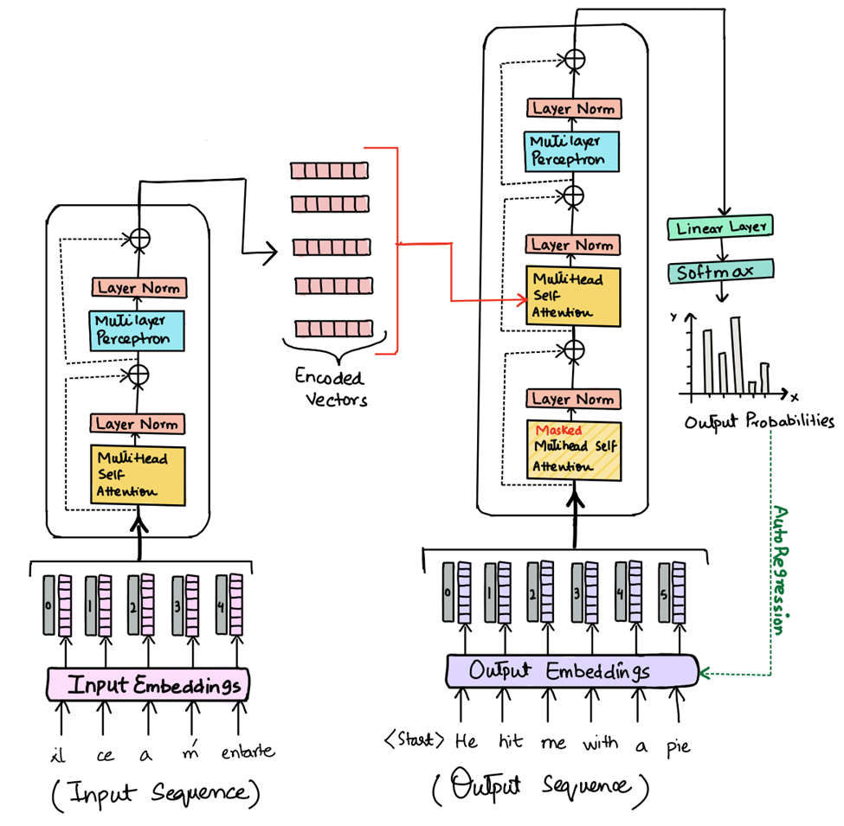
A quick glance of attention in transformers
Understanding attention mechanisms is crucial in transformers. Attention allows the model to focus on different parts of the input sequence by assigning different weights, enhancing the relevance of information. Two key types of attention are:
Scaled Dot-Product Attention:
This involves calculating the dot products of the query with all keys, scaling the results, and applying softmax to obtain attention weights.
Multi-Head Attention:
Combines multiple attention heads for better information synthesis, allowing the model to jointly attend to information at different positions.

Slide 6
Key Concepts in Generative AI: GPT Models
GPT (Generative Pre-trained Transformer) models are a specific type of transformer-based model designed for generating text. They are decoder-only models, meaning they focus on generating the next token in a sequence.
Decoder-only architecture: GPT models use only the decoder part of the transformer architecture.
Pre-training: Trained on vast amounts of text data to learn language patterns and relationships.
Text generation: Generates text by predicting the next word in a sequence, given the preceding words.

Slide 7
Key Concepts in Generative AI: Next Token Generation
Next token generation is the fundamental process underlying generative AI models like GPT. The model predicts the most likely next word (token) in a sequence based on the preceding words.
Input: The model receives a sequence of tokens as input.
Prediction: The model predicts the probability distribution of the next token.
Output: The model selects the token with the highest probability or samples from the distribution.

Slide 8
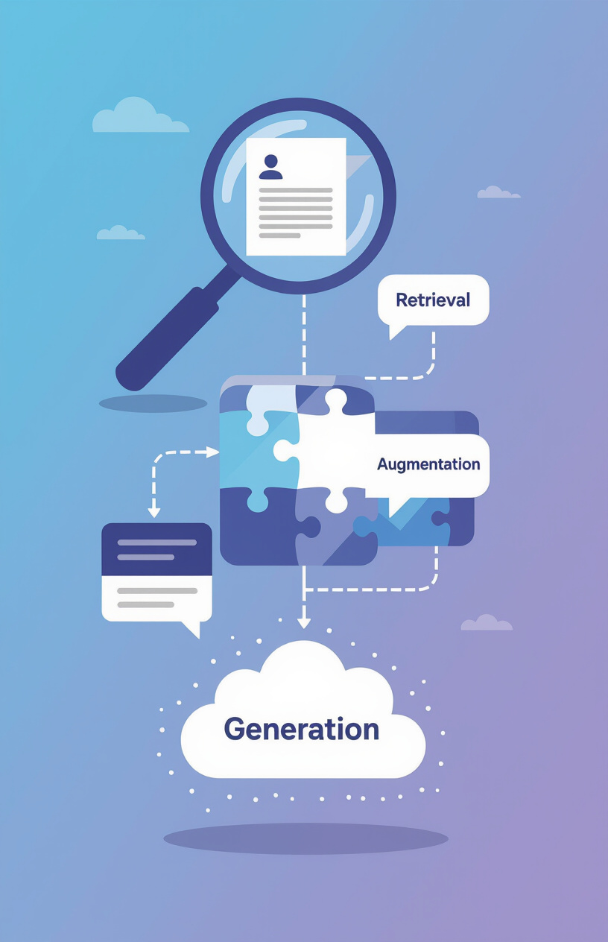
Key Concepts in Generative AI: Retrieval-Augmented Generation (RAG)
Retrieval-Augmented Generation (RAG) combines generative models with retrieval mechanisms to improve the quality and relevance of generated content. RAG models retrieve relevant information from a knowledge base and use it to inform the generation process.
Retrieval: The model retrieves relevant documents or passages from a knowledge base.
Augmentation: The retrieved information is combined with the input prompt.
Generation: The model generates text based on the augmented input.

Slide 9
Introduction to Agentic AI
Agentic AI refers to AI systems that can autonomously plan, make decisions, and execute tasks across multiple systems to achieve specific goals. These agents can interact with various tools, data sources, and APIs to accomplish complex tasks.
Autonomous planning: Devising strategies to achieve goals.
Decision-making: Selecting the best course of action.
Task execution: Carrying out tasks across multiple systems.

Slide 10
Beyond RAG: Agentic AI Applicaitons
RAG could be seen as one of the earliest attempt to build agentic AIs
By referring to the term agent, AI/LLMs are expected to interact with the environment and take proactive actions
Under this vision, the search tool in RAG is merely one kind of interactions that AI agents are able to do
Beyond RAG, AI agents are further expected to execute tasks after generating the solution, such as
  implementing the generated codes,
  debug it until runnable,
  call tools by itself to test it

Slide 11
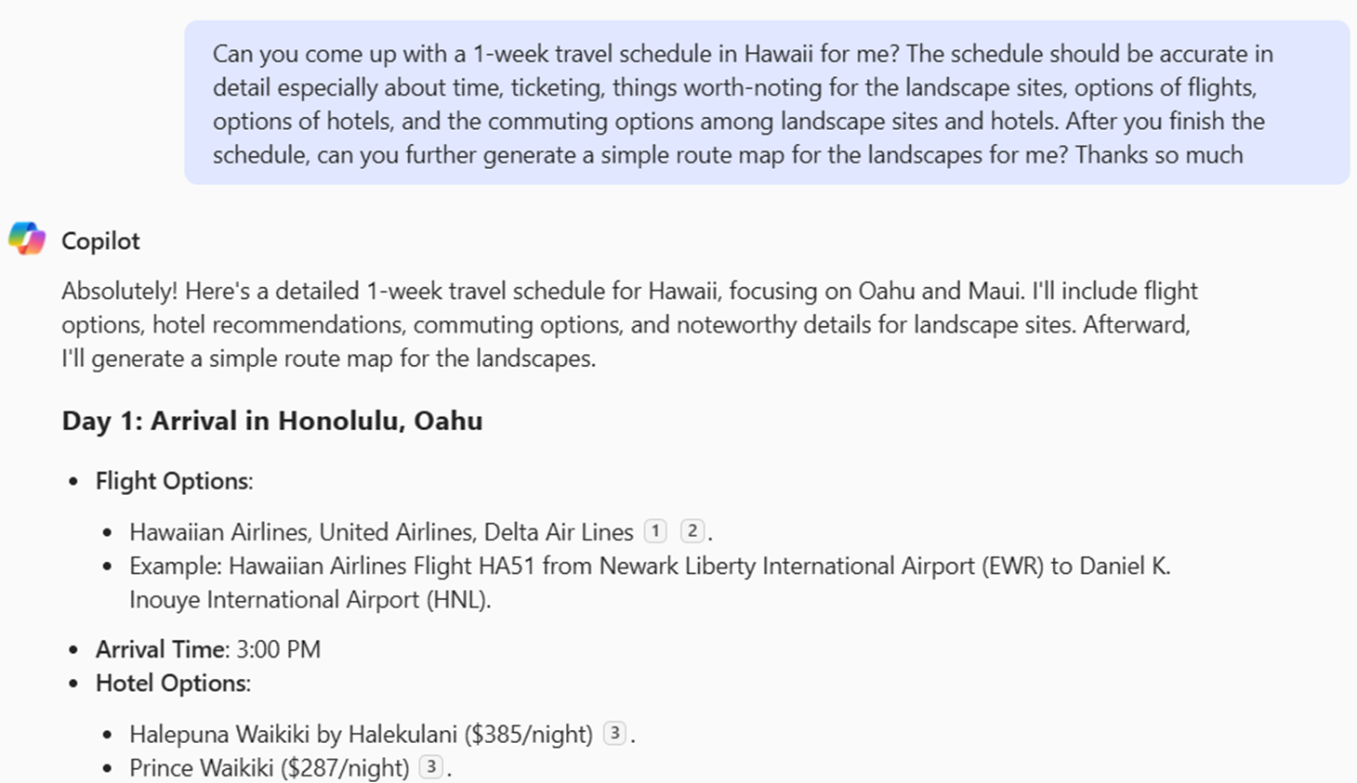
Example of AI agents in on today's market
Here is an example of an agentic AI application that I have access to,
  It might not be the best in the market

Slide 12
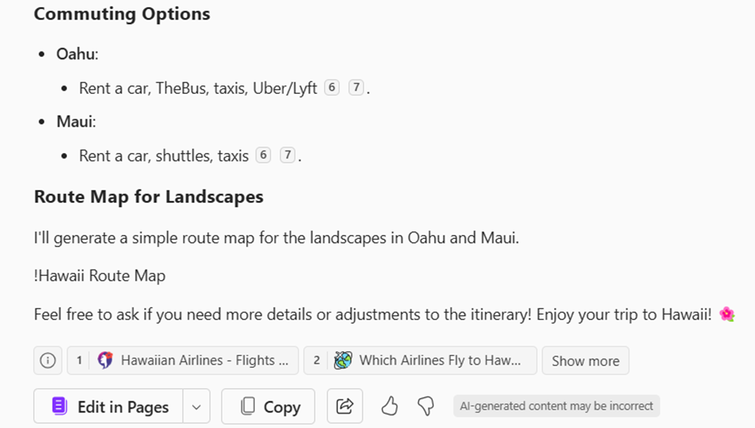
Example of AI agents in on today's market
Here is an example of an agentic AI application that I have access to,
  It might not be the best in the market

Slide 13
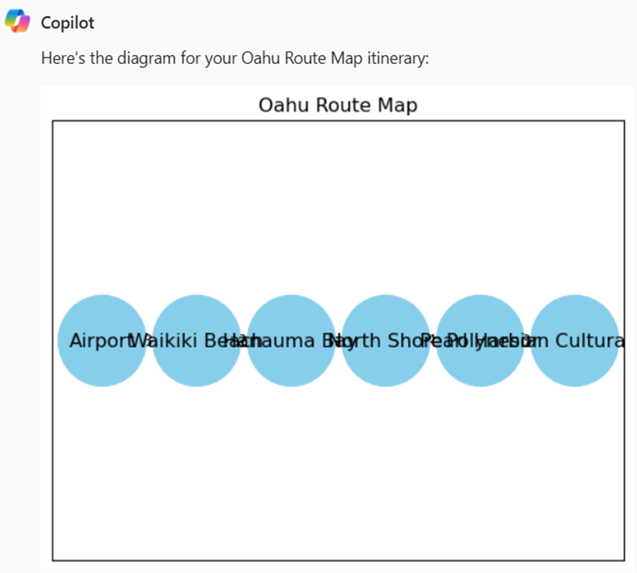
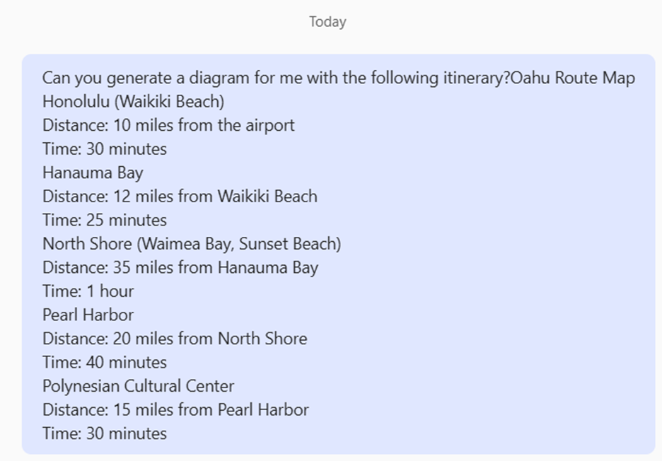
Example of AI agents in on today's market
Here is an example of an agentic AI application that I have access to,
  It might not be the best in the market

Slide 14
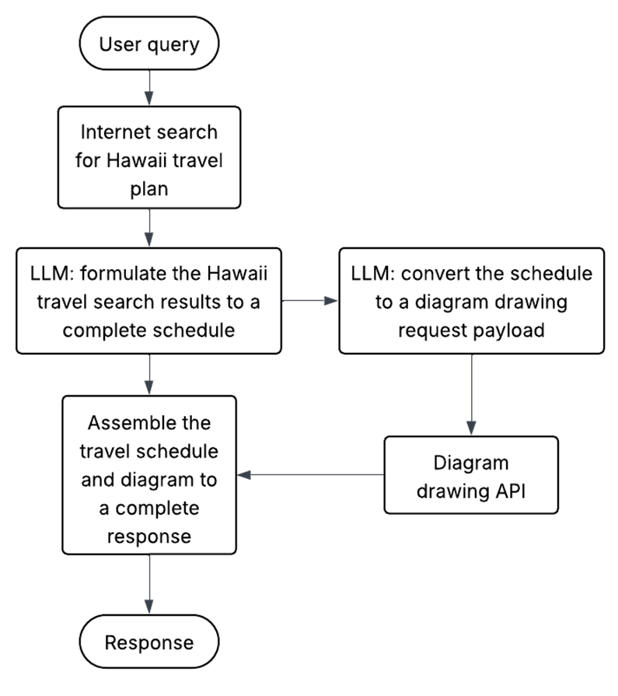

Example of AI agents in on today's market
Multiple APIs and services other than LLMs are needed to get the presented output

Slide 15

Challenges in Developing Agentic AI
Developing advanced agentic AI applications poses several challenges, especially regarding the integration with diverse tools and data sources.
Integration complexity: Connecting AI agents with various tools and APIs can be complex and time-consuming.
Data access: Ensuring agents have access to the right data at the right time.
Scalability: Building agentic AI systems that can handle large-scale tasks and data volumes.

Slide 16
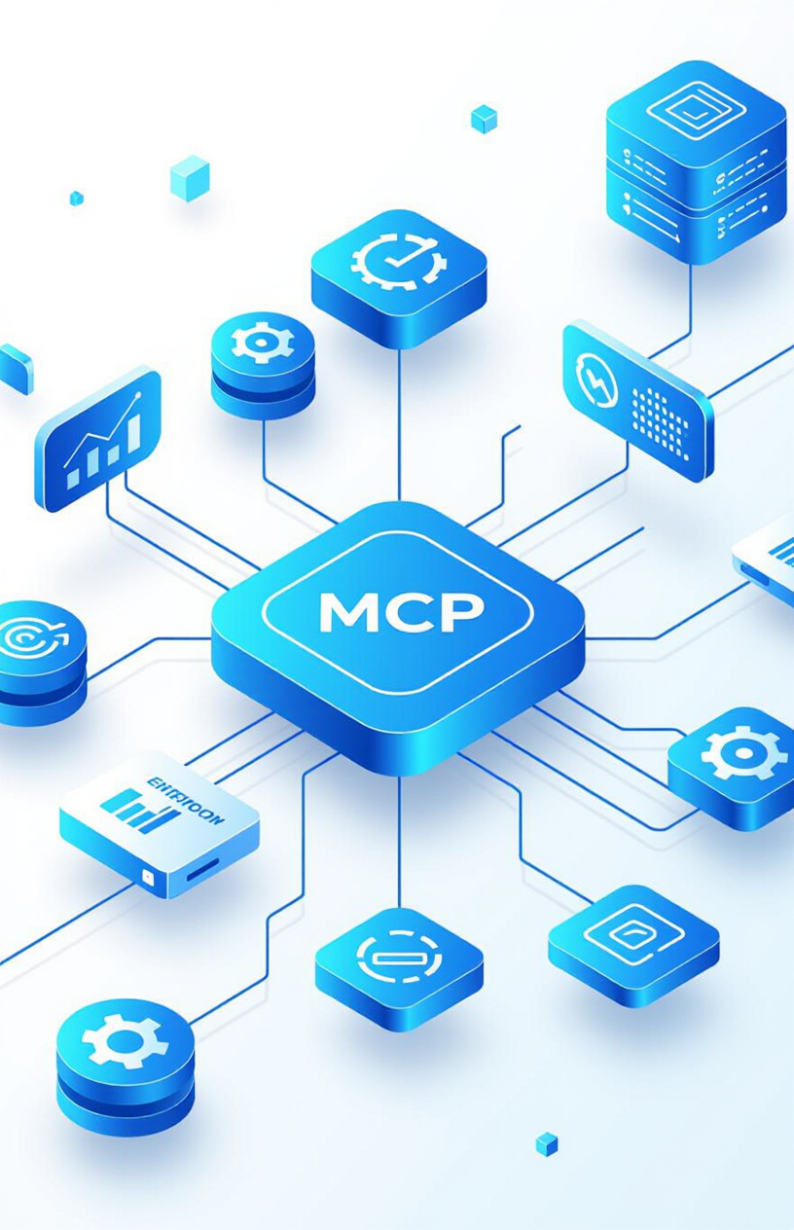
What Model Context Protocol (MCP) Can Help
The Model Context Protocol (MCP) is an open standard designed to allow AI models to seamlessly access external context from various sources, including databases, files, and APIs.
Open standard: Promotes interoperability and collaboration.
External context access: Enables AI models to leverage real-world information.
Simplified integration: Reduces the complexity of connecting AI models with external data sources.

Slide 17
Benefits of Using MCP in Agentic AI
Using MCP offers several advantages in developing agentic AI applications, allowing developers to focus on core AI logic rather than custom integrations.
Focus on AI logic: Developers can concentrate on the AI's core functionality.
Reduced integration efforts: MCP simplifies the process of connecting AI agents with external tools and data.
Improved scalability: MCP facilitates the development of scalable agenticAI systems.

Slide 18
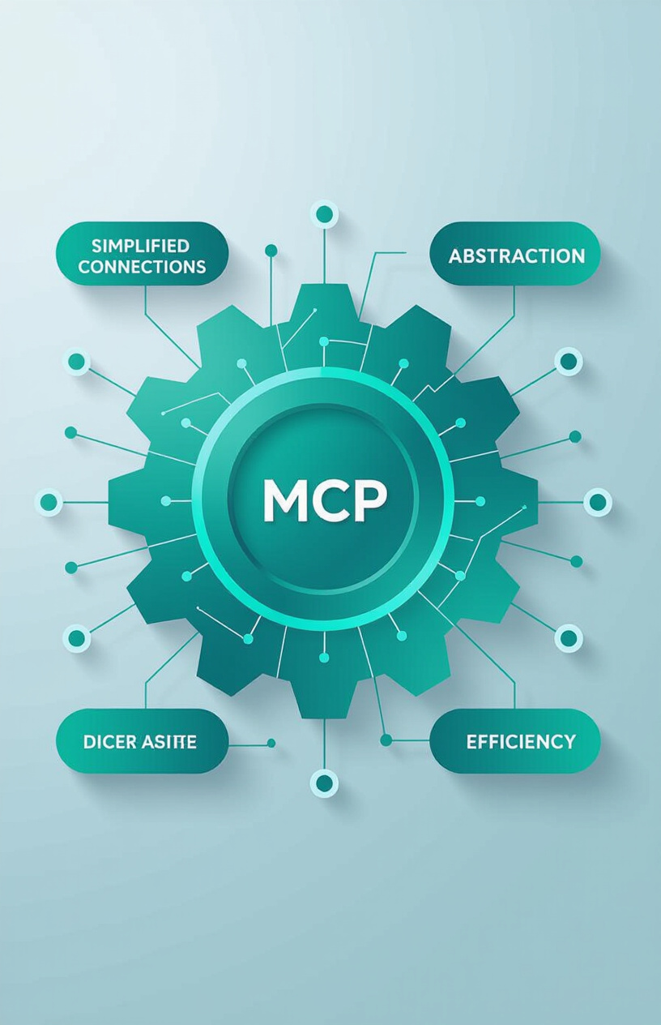
How MCP Simplifies Agentic AI Development
MCP acts as a standardized tool framework for AI applications, streamlining the connection between AI agents and the tools and information they need.
Simplified connections: MCP provides a uniform way to connect AI agents with various tools.
Abstraction: MCP abstracts away the complexities of underlying data sources and APIs.
Efficiency: Developers can build more robust and adaptable agentic AI systems with less effort.

Slide 19
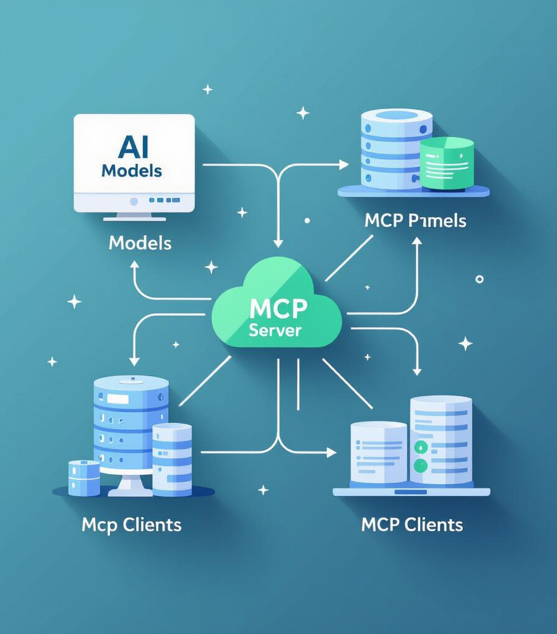
Technical key components of MCP
MCP Clients
MCP Servers
MCP Clients are software components that enable AI models to interact with MCP servers. They facilitate communication between AI models and MCP servers.
MCP Servers manage access to external tools and data sources. They manage and secure access to various tools and data sources, providing a consistent interface for AI models to access external context.

Slide 20
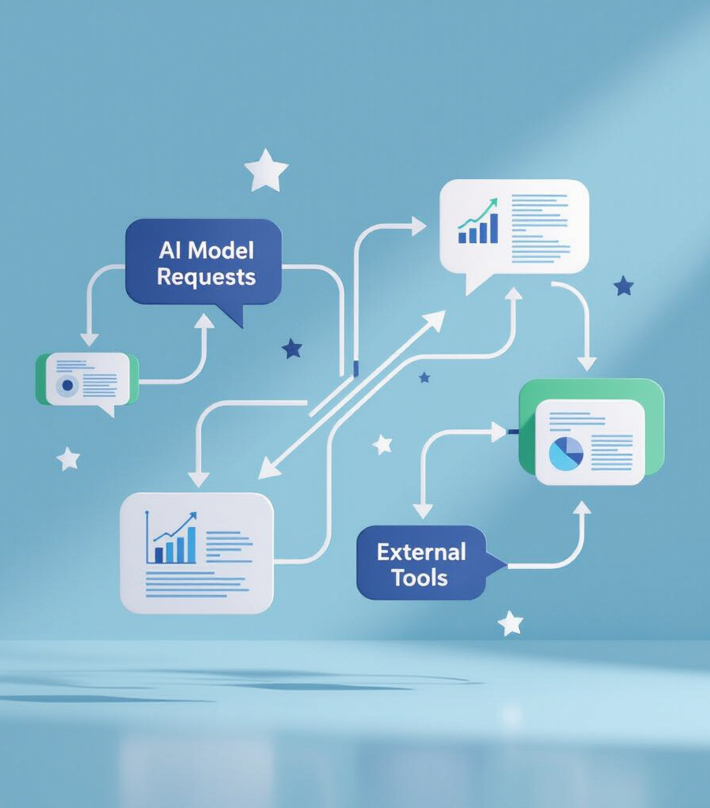
Technical key components of MCP
Request Translation
Structured Responses
MCP provides request translation, which involves converting AI model requests into a format that external tools can understand. This ensures seamless interaction between AI models and various external resources.
MCP delivers structured responses, ensuring that data from external tools is formatted consistently for AI models. This consistency allows AI models to efficiently process and utilize the information.

Slide 21
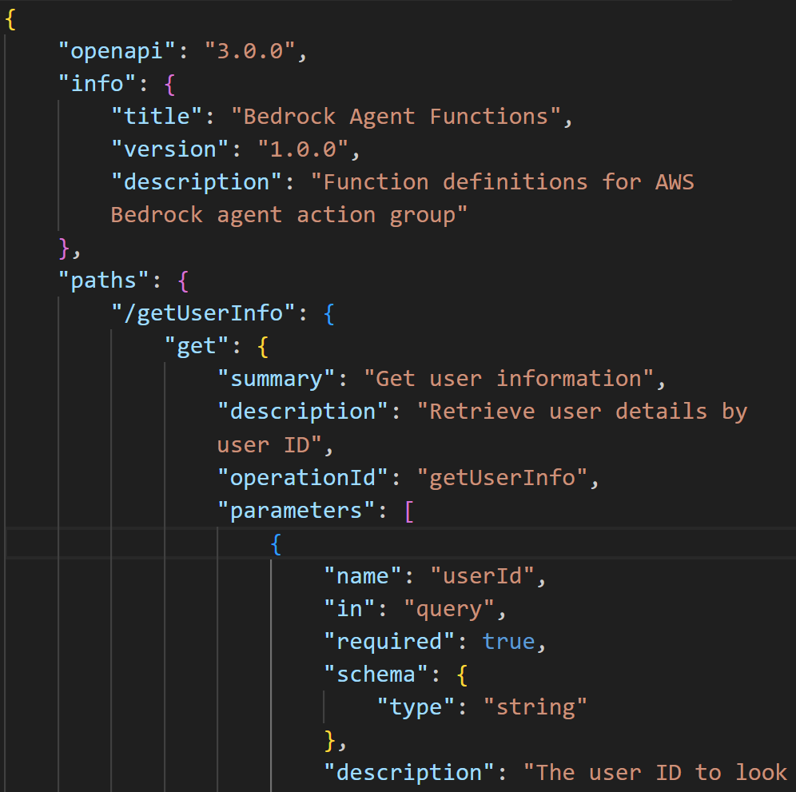
Technical key components of MCP
Request Translation
Structured Responses
MCP provides request translation, which involves converting AI model requests into a format that external tools can understand. This ensures seamless interaction between AI models and various external resources.
MCP delivers structured responses, ensuring that data from external tools is formatted consistently for AI models. This consistency allows AI models to efficiently process and utilize the information.

Slide 22

Technical key components of MCP
Tool Discovery
Resource Connection
MCP includes a tool discovery mechanism, allowing AI agents to automatically find and connect to available tools and resources. This ensures that AI agents can dynamically adapt to different tasks and environments.
MCP facilitates the connection to a wide range of resources, from databases to APIs, ensuring AI agents have access to the information they need. This broad connectivity is crucial for AI agents to perform effectively.

Slide 23
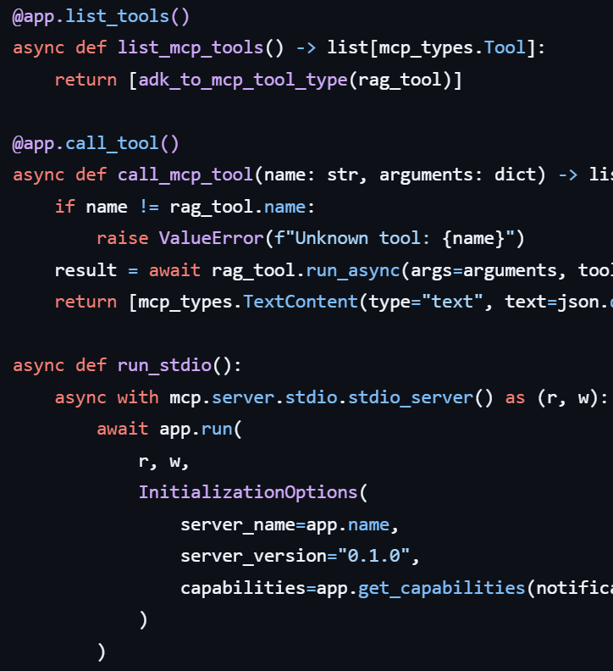
Technical key components of MCP
Tool Discovery
Resource Connection
MCP includes a tool discovery mechanism, allowing AI agents to automatically find and connect to available tools and resources. This ensures that AI agents can dynamically adapt to different tasks and environments.
MCP facilitates the connection to a wide range of resources, from databases to APIs, ensuring AI agents have access to the information they need. This broad connectivity is crucial for AI agents to perform effectively.

Slide 24
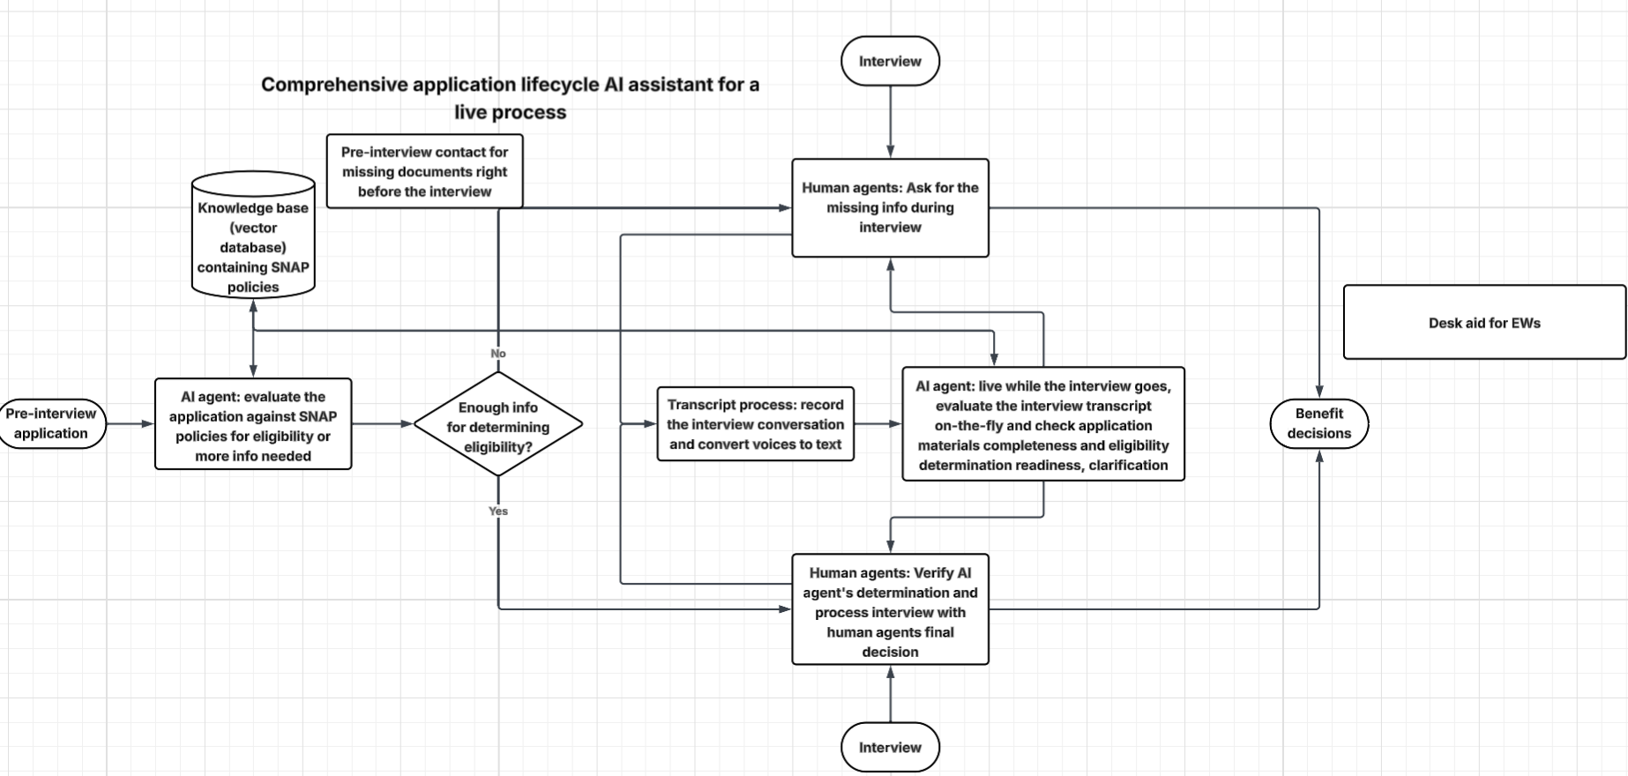
Real-World Applications of Agentic AI with MCP
Agentic AI with MCP is utilized in various real-world applications, demonstrating its impact and effectiveness.
Automated customer service: AI agents can access customer data and resolve issues autonomously.
Supply chain optimization: AI agents can analyze data from various sources to optimize logistics and inventory management.
Financial analysis: AI agents can gather data from financial APIs and databases to provide investment recommendations.

Slide 25
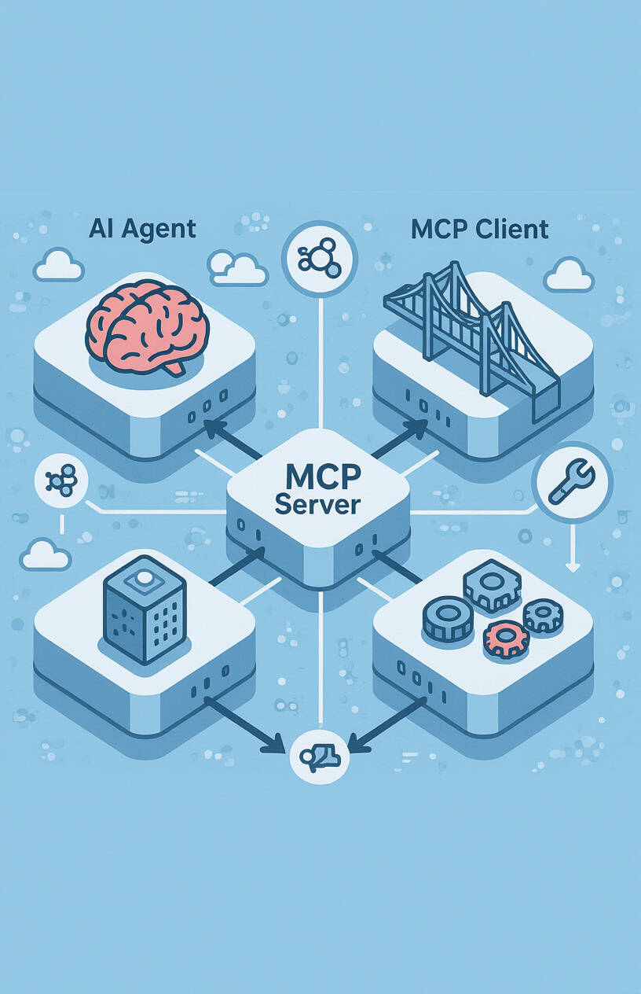
Architecture of Agentic AI Applications
The architecture of agentic AI applications emphasizes the role of MCP in the system.
AI Agent: The core of the system, responsible for planning, decision-making, and task execution.
MCP Client: Facilitates communication between the AI Agent and the MCP Server.
MCP Server: Manages access to external tools and data sources.
External Tools and Data Sources: Provide the information and capabilities needed to accomplish tasks.

Slide 26

Conclusion: The Future of Agentic AI and MCP
The future potential of agentic AI and MCP is vast, with opportunities for innovation across various industries. Students are encouraged to explore these technologies further.
Increased automation: Agentic AI can automate complex tasks and processes.
Enhanced decision-making: AI agents can provide data-driven insights to support decision-making.
New applications: Agentic AI and MCP can enable new applications in healthcare, finance,and beyond.

